Slide 1

Brachytherapy Calculations
RT4220 – Lecture #16
Kedree Proffitt
WSU
11/18/2025

Slide 2
Additional Intro To Brachy Stuff
Have even more brachy!

Slide 3
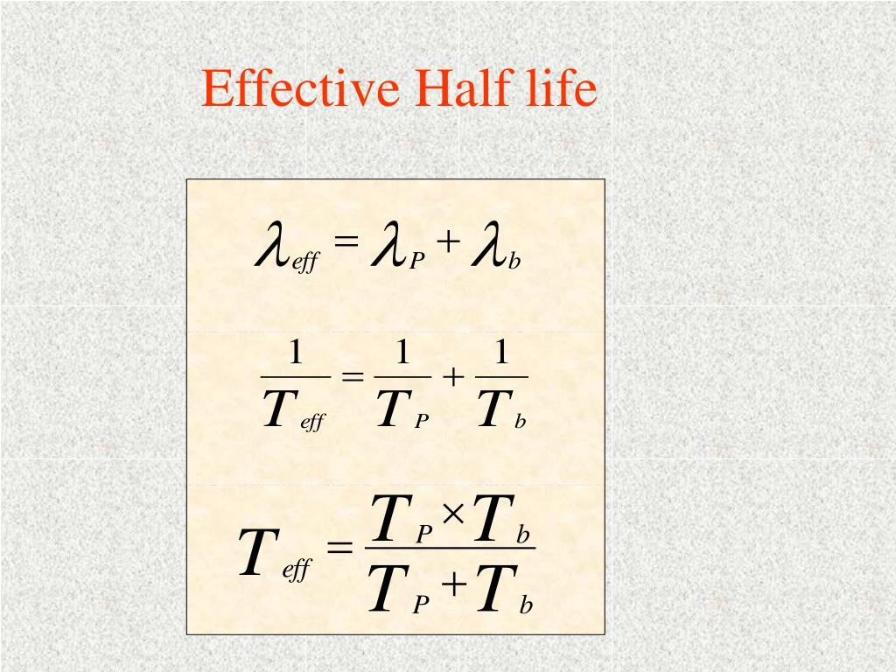

Slide 4
Historical Perspective
Initially most treatment techniques were developed with radium
Modern dosimetry is still associated with radium
Safety concerns about radium
Radium decays to radon (a gas)
In a sealed chamber (seed), gas builds up
Gas leak
Radioactive material dissemination
Artificial radionuclides are now used
Useful energies for therapy treatments
Convenient half-life’s

Slide 5
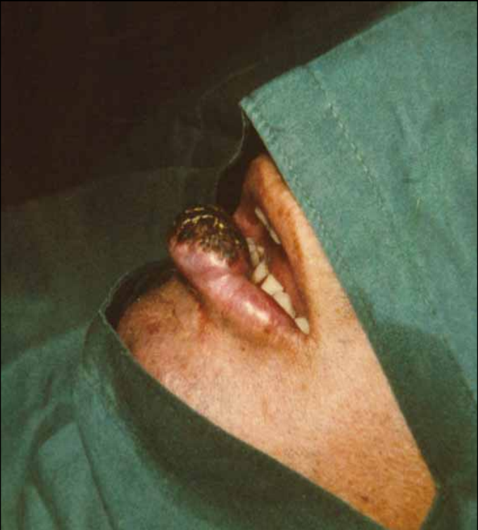
Lower Lip Tumor (example)
53 year old patient
Surgery could remove tumor but the patient would lose partial function of the lip

Slide 6
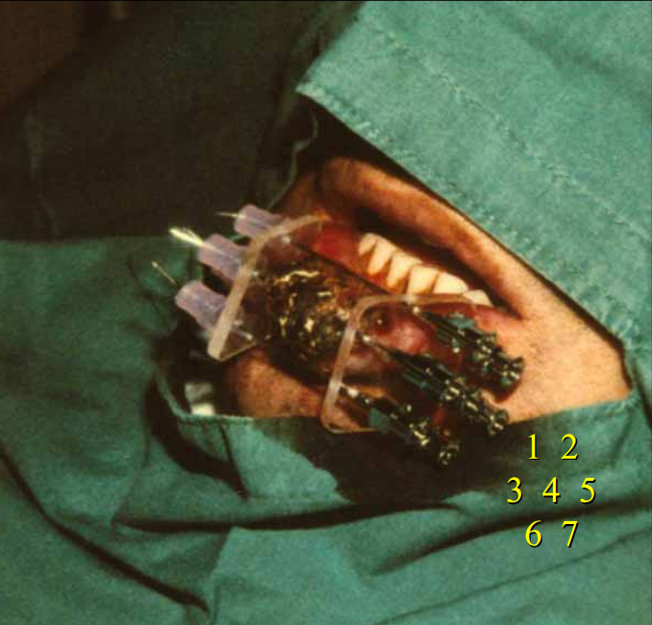
7 Iridium-192 Needles
Custom plaque for inserting sources
Local anesthetic
6 day treatment

Slide 7
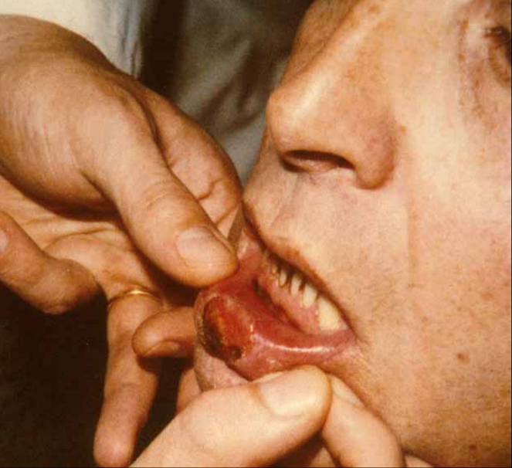
One Month Later…

Slide 8
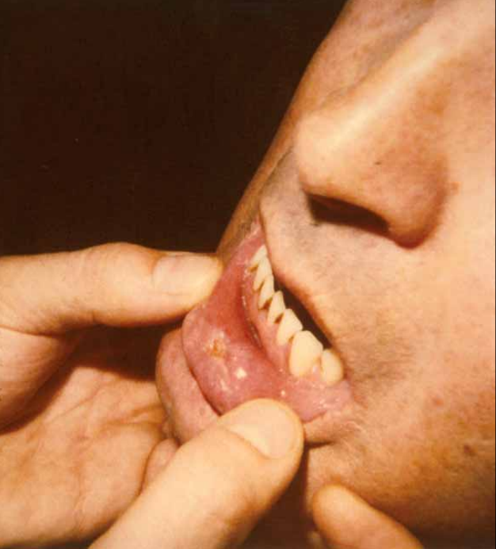
Two Months Later…

Slide 9
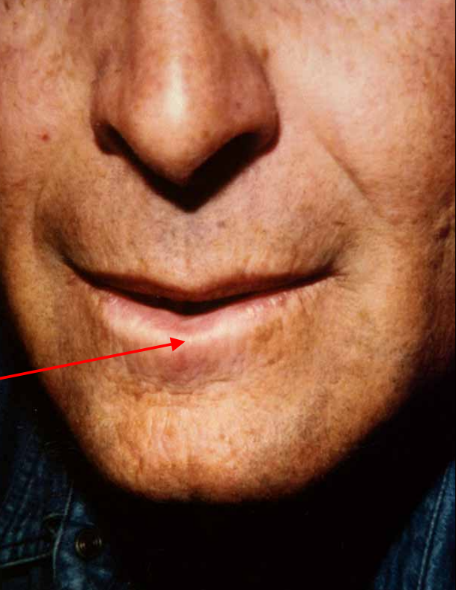
Four Months Later

Slide 10
Dose Rate
Want to achieve maximum dose to tumor and keep acceptable toxicity to surrounding normal tissue
Depends upon:
Number of sources
Geometric distribution
Volume of target tissue
Radiobiology of tumor vs. normal tissues

Slide 11
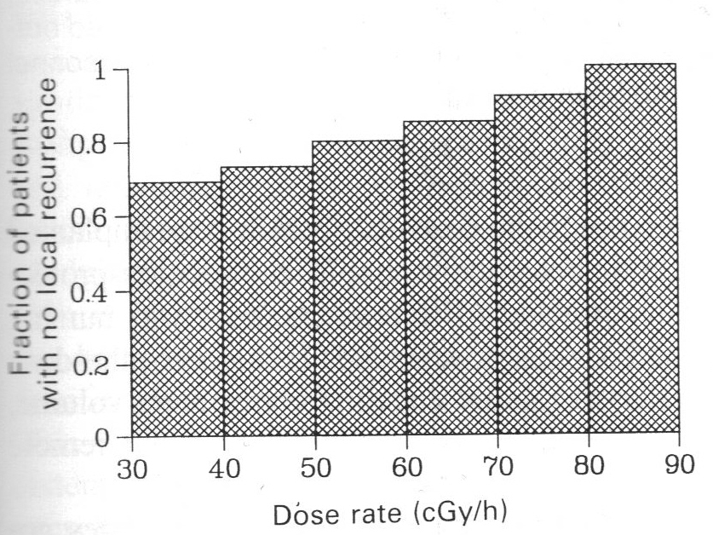
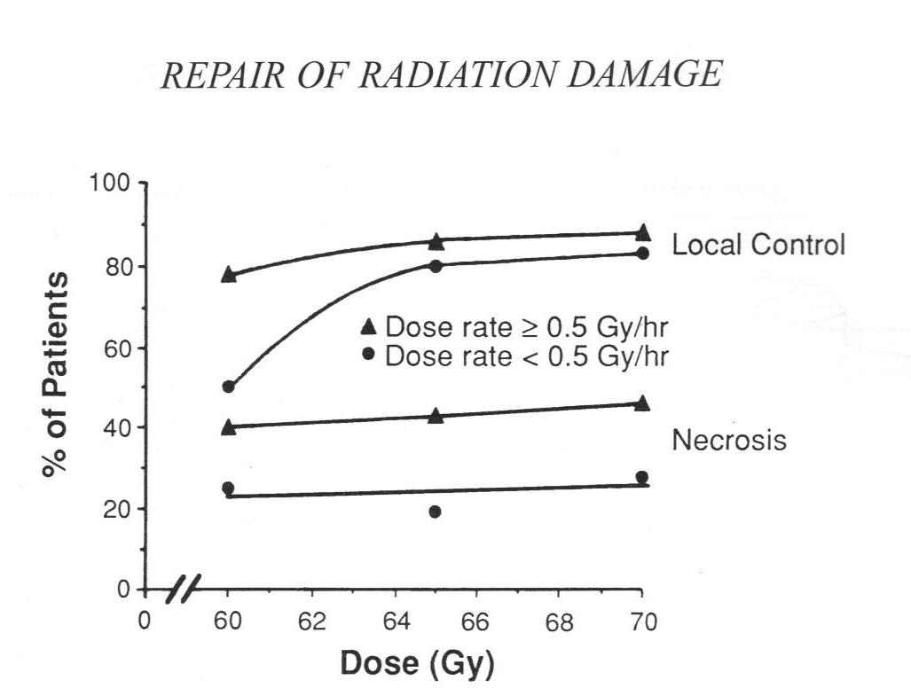
Dose Rate
The biological effectiveness depends upon dose rate
Long term effects (toxicities) also depend upon dose rate

Slide 12
Radiobiology of Dose Rate
To increase the survivability of healthy cells one should try to:
Reduce dose rate or
Extend treatment
This allows repopulation of healthy cells
This is why HDR is fractionated
Notes:
More complicated- low dose rate benefits late-reacting normal tissues more than cancers, so in theory low dose rate radiotherapy better.

Slide 13
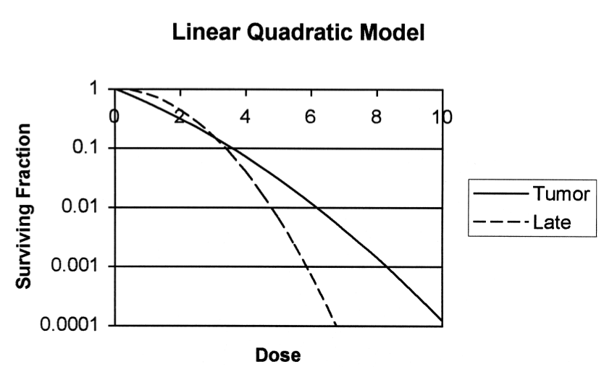
Radiobiology of LDR vs. HDR
α = unrepairable damage; β = repairable damage
α/β ratios determine the “bendiness” of the cell survival curve for a particular tissue under radiation

Slide 14
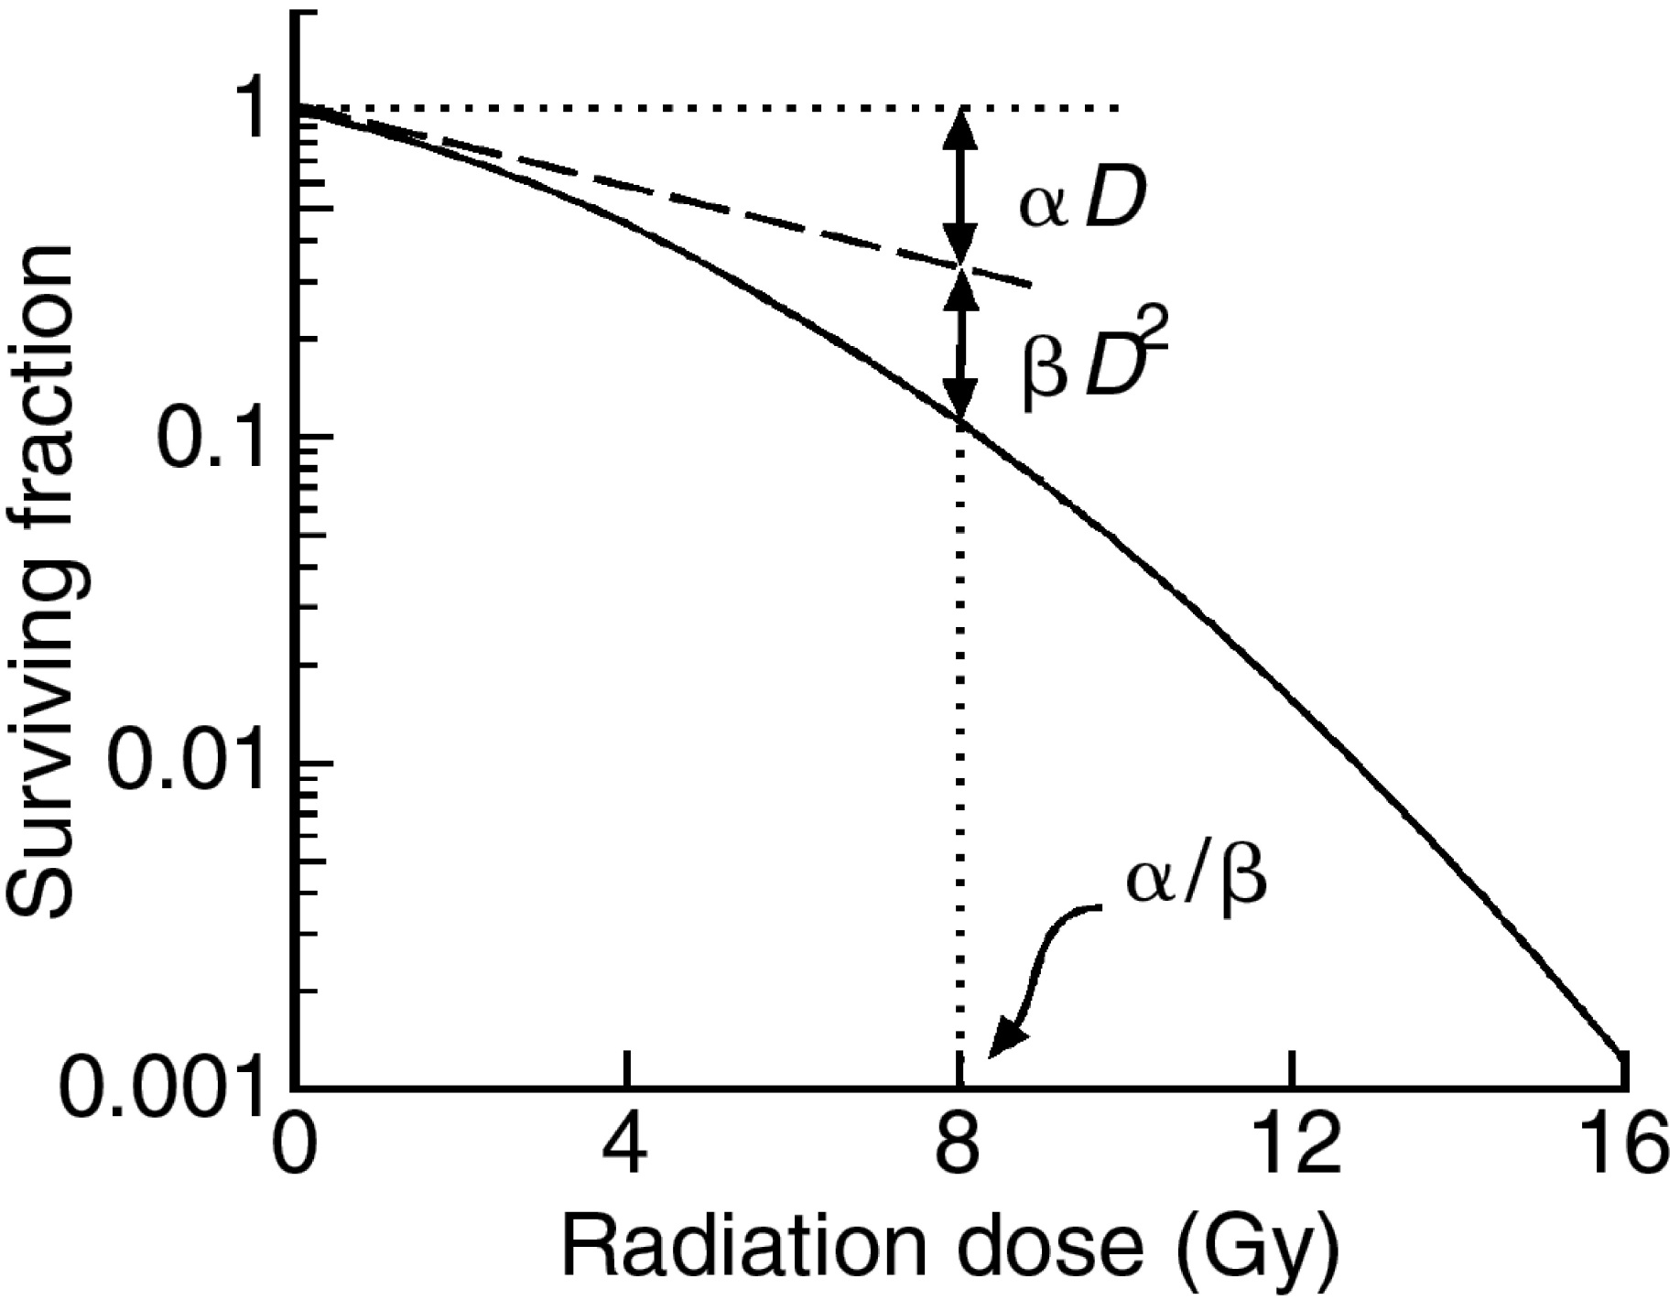
Low α/β
High α/β

Slide 15
Radiobiology of LDR vs. HDR
If the α/β of normal tissue is less than the α/β of a tumor, LDR is better
Early responding tissues have a high alpha beta ratio
Skin, bone-marrow, intestinal epithelium
Rapidly dividing cells
Late responding tissues have a low alpha beta ratio
Spinal Cord, lung, kidney
Most tumors have a high alpha beta ratio
Some tumors have a low alpha beta ratio
Melanoma, sarcoma, prostate, breast

Slide 16
HDR vs. LDR
Comparing HDR to LDR
Clinical outcome
Toxicities
Radiobiological effectiveness depends on tumor repair vs. normal tissue repair
Target for HDR
Just be equal to LDR (does not have to be better) because of other benefits
Increased patient numbers
Outpatient treatment
Trend is moving toward HDR

Slide 17
LDR Brachytherapy
Advantages
Biological advantage for normal tissues vs. tumor tissues
Does not require large amounts of shielding
Disadvantages
Requires long time to deliver therapeutic dose
Often requires hospitalization
Limited number of patients can be treated

Slide 18
HDR Brachytherapy
Advantages
Short duration treatment time
Increase patient population
More precise dose distribution than LDR
HDR often used as a boost or even primary treatment for prostate cancer
Disadvantages
Dose to staff more of a concern
Must use a remote afterloader
Radiobiology can be an issue

Slide 19
HDR Source
Iridium-192
Small line source welded to end of a flexible drive cable
Ir-192 source of 5-10 Ci provides a dose rate of 7Gy/min at 1cm from the source.
Source dimensions
0.3 to 0.6 mm diameter
3.5 to 10 mm long
Storage of source wire (when not in use)
In shielded safe or vault (Tungsten or depleted uranium )
1 mR/h at 10 cm

Slide 20
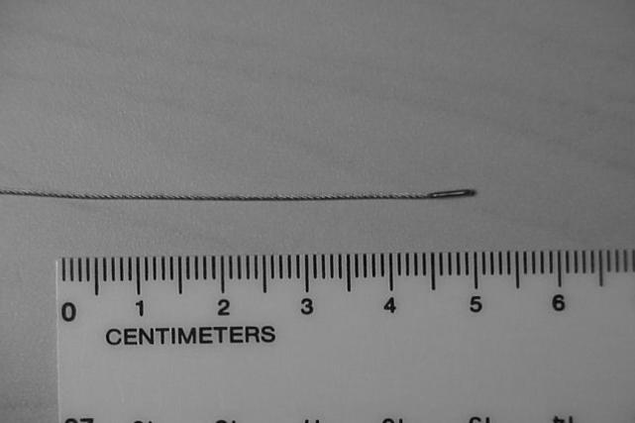
Radioactive Source

Slide 21
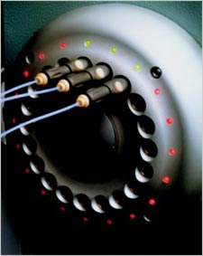
HDR Channels
HDR has several channels
Indexer system delivers sources from vault to channel
Applicators or catheters connected to channels
Transfer tubes / guides
Dummy source wires used as QA to verify path is clear of obstructions

Slide 22
Brachytherapy Calculations
Meat and… nay, but potatoes!

Slide 23
Quantities For Source Specification
A_{app} (Apparent Activity)
Activity of an un-encapsulated source delivering the same activity as the encapsulated source
Exposure Rate
Exposure rate constant “Γ”
Milligrams Radium equivalent (MgRa_{eq})
S_{k}: Air Kerma Strength (U, or μGy*m² / hr)
Kerma = Kinetic Energy Released in MAtter
Reference energy transfer / dose rate currently used for source calibration and brachytherapy dosimetry
Reference Air kerma rate measured at 1 meter in air

Slide 24
Apparent Activity
Actual activity not particularly useful quantity because the source is encapsulated
Apparent activity
Activity of an un-encapsulated source producing the same exposure as the encapsulated source
Allows the use of activity for dose calculation without explicit knowledge of source encapsulation

Slide 25
Exposure Rate Constant (Γ)
Tabulated constant
Assigned to source based on ionization measured in air
Typical Γ units:
R*cm²/(mg*hr), when working in “mg Radium”
R*cm²/(mCi*hr)

Slide 26
Exposure Rate Constant (Γ)
= Exposure rate (R/hr, R/s, etc)
A = Apparent activity (Ci, mCi, Bq, etc)
Γ = Exposure rate constant
r = distance from source

Slide 27
Radium-226
The curie is the historical unit for activity
1 Ci = decays per second in 1g of radium
1g radium ≈ 1 Ci = 3.7 x 10¹⁰ Bq (we now know that 1g of Radium measures closer to 0.98Ci)
This is why we can have different units for Γ_{Ra}:
Γ_{Ra} = 8.25 R*cm²/mCi*hr or
Γ_{Ra} = 8.25 R*cm²/mg*hr

Slide 28
Radium Equivalence
Older treatment protocols may call for a mass of Radium instead of exposure rate or dose
Other radionuclides may be substituted for Radium using exposure rate constants (Γ)

Slide 29
Common Exposure Rate Constants (Γ)
Radionuclide Γ (R*cm²/mCi*hr)
Ra-226 8.25
Co-60 13.07
Cs-137 3.28
Au-198 2.327
Ir-192 4.62
Pd-103 1.48

Slide 30
Radium Equivalence Ratios
mgRa_{eq} = A_{app} * Γ_{x} / Γ_{ra} mgRa_{eq} = * r² / Γ_{ra}
Apparent Activity of isotope
Exposure Rate Constant of isotope
Exposure Rate Constant for Radium (Γ_{ra})

Slide 31
Exposure to Dose Rate: Air Kerma Strength
Now relate exposure in air (X) to dose
Can get Exposure from Activity, Distance, Time and the Exposure rate constant
KERMA
Kinetic Energy Released per unit Mass
All KE given to charged particles from uncharged particles
Proportional to Dose

Slide 32
Kerma
Indirectly ionizing radiation (photons and neutrons) deposit energy:
Kinetic energy imparted to electrons/nuclei is then deposited as dose downstream

Slide 33
Exposure to Dose Rate: Air Kerma Strength
Air Kerma:
K = X (W/e)
X = exposure [R]
(W/e) = average energy to create ion pair [J/C or eV/i.p.]
Air Kerma Strength: S_{k} = dK(r)/dt * r²
Change in Air Kerma per unit time * area
Units of “U” [μGy*m²/hr] or [cGy*cm²/hr]
Source with 1U produces:
1cGy/h at 1 cm from source
1μGy/h at 1 m from source

Slide 34
Common Air Kerma Strength Conversions @ 1m
1U (μGy m²/h)
= 0.348 mCi for ¹³⁷Cs
= 0.243 mCi for ¹⁹²Ir
= 0.486 mCi for ¹⁹⁸Au
= 0.787 mCi for ¹²⁵I
= 0.773 mCi for ¹⁰³Pd

Slide 35
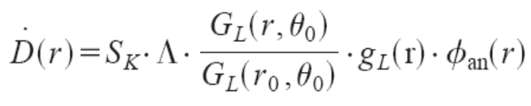
Air Kerma Strength – Why?
Source specification
TG-43:
Don’t panic I won’t test you too hard on this…
Accounts for variations due to dose distribution, drop off, absorption, scatter, filtration, geometric effects for any point.
Dose rate at a point
Air Kerma Strength
Dose rate constant

Slide 36
Important Calculation Definitions
Poke ya prostate, Yank ya Uterus

Slide 37
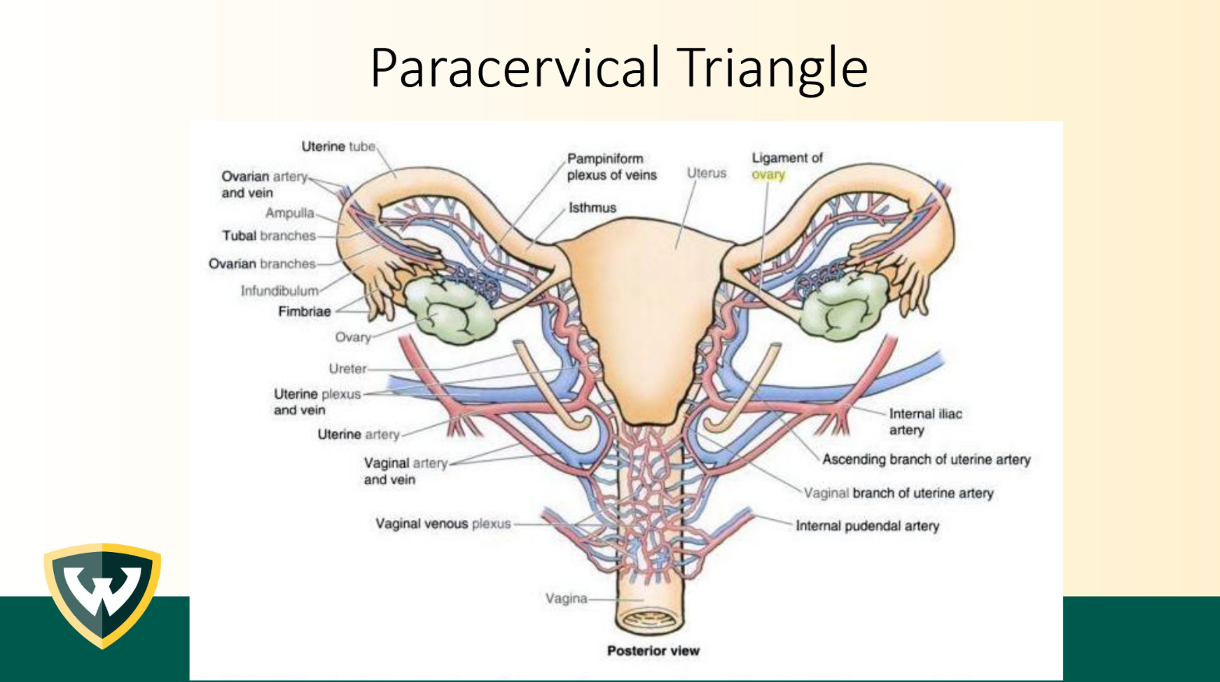

Slide 38
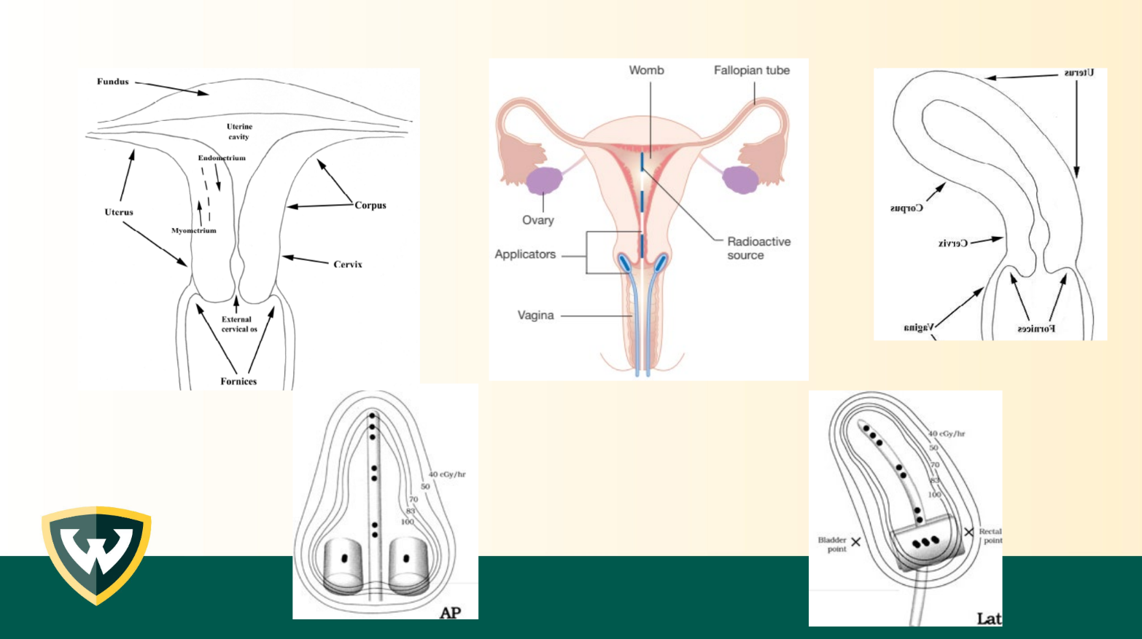
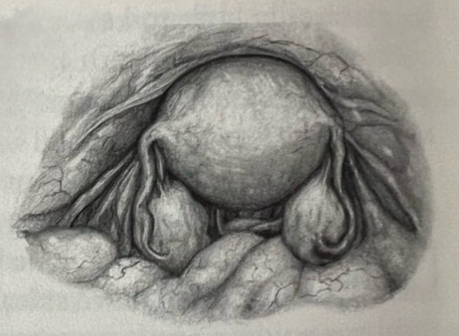

Slide 39
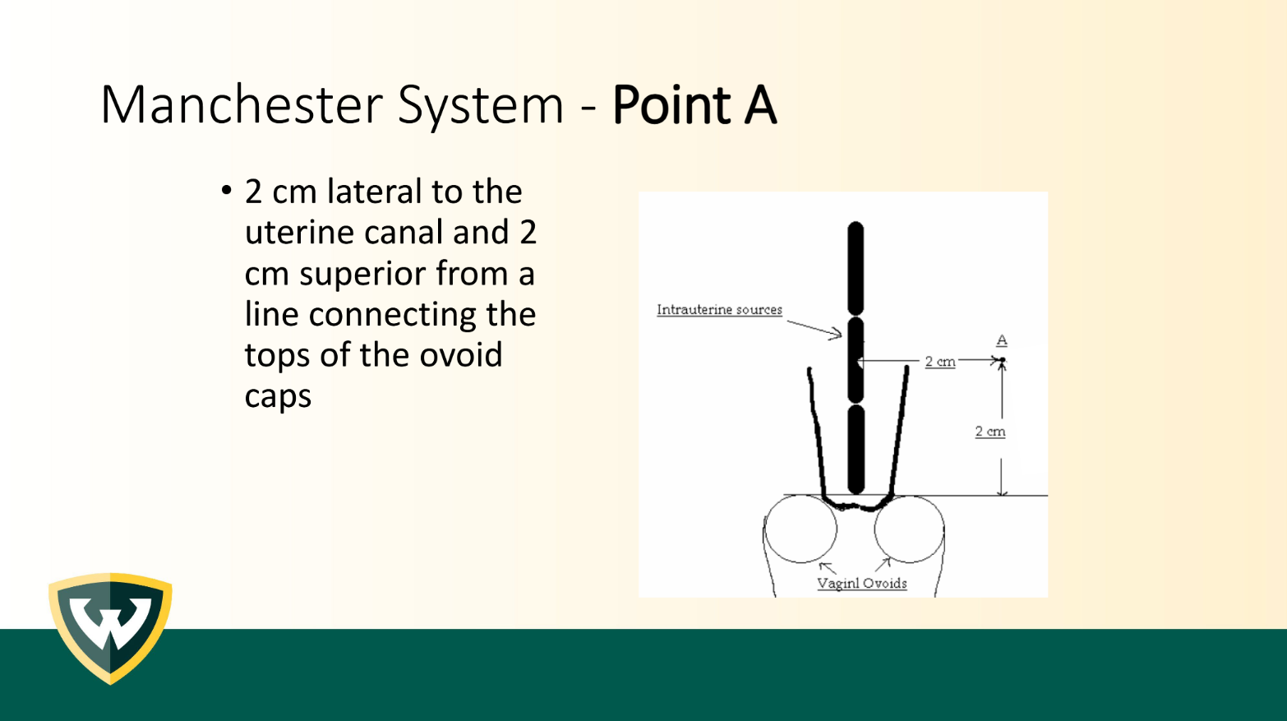

Slide 40
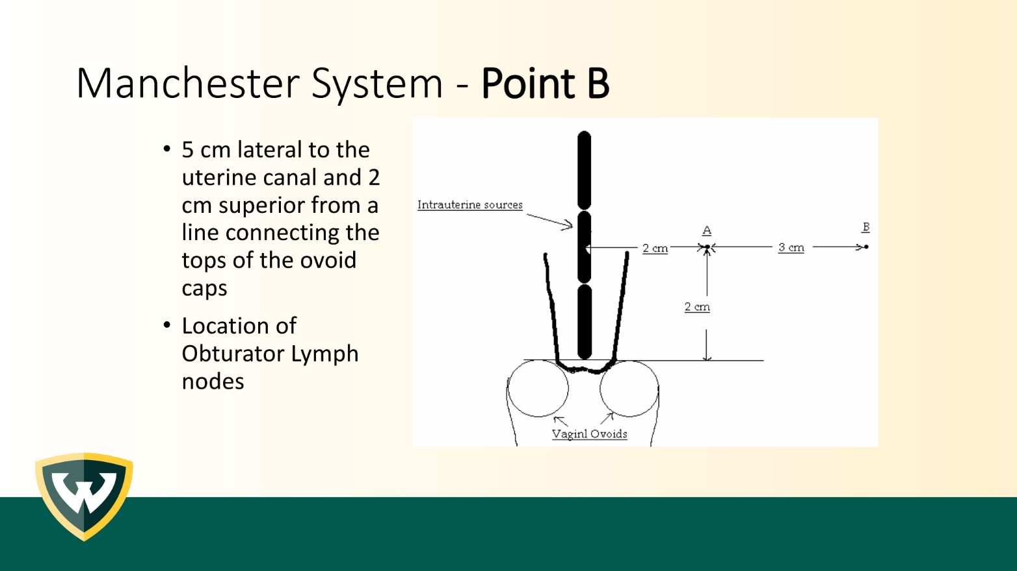

Slide 41
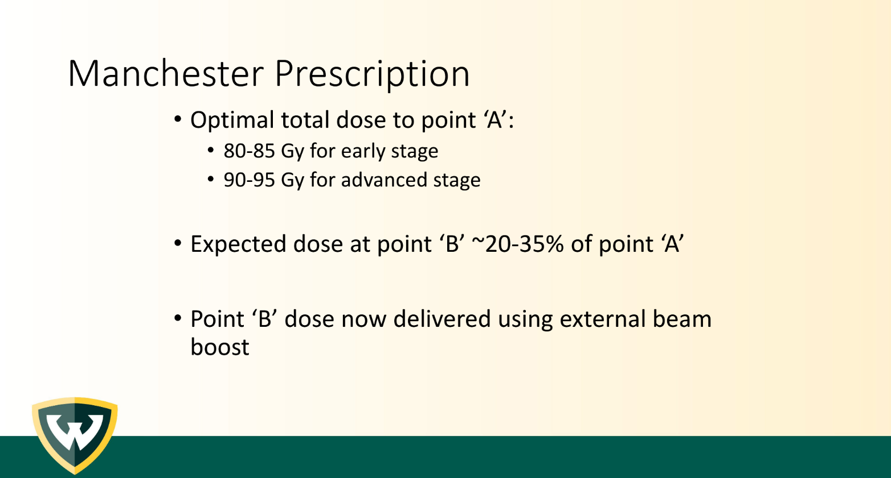

Slide 42
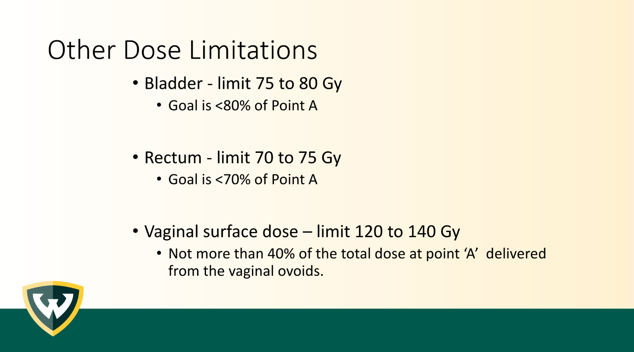

Slide 43
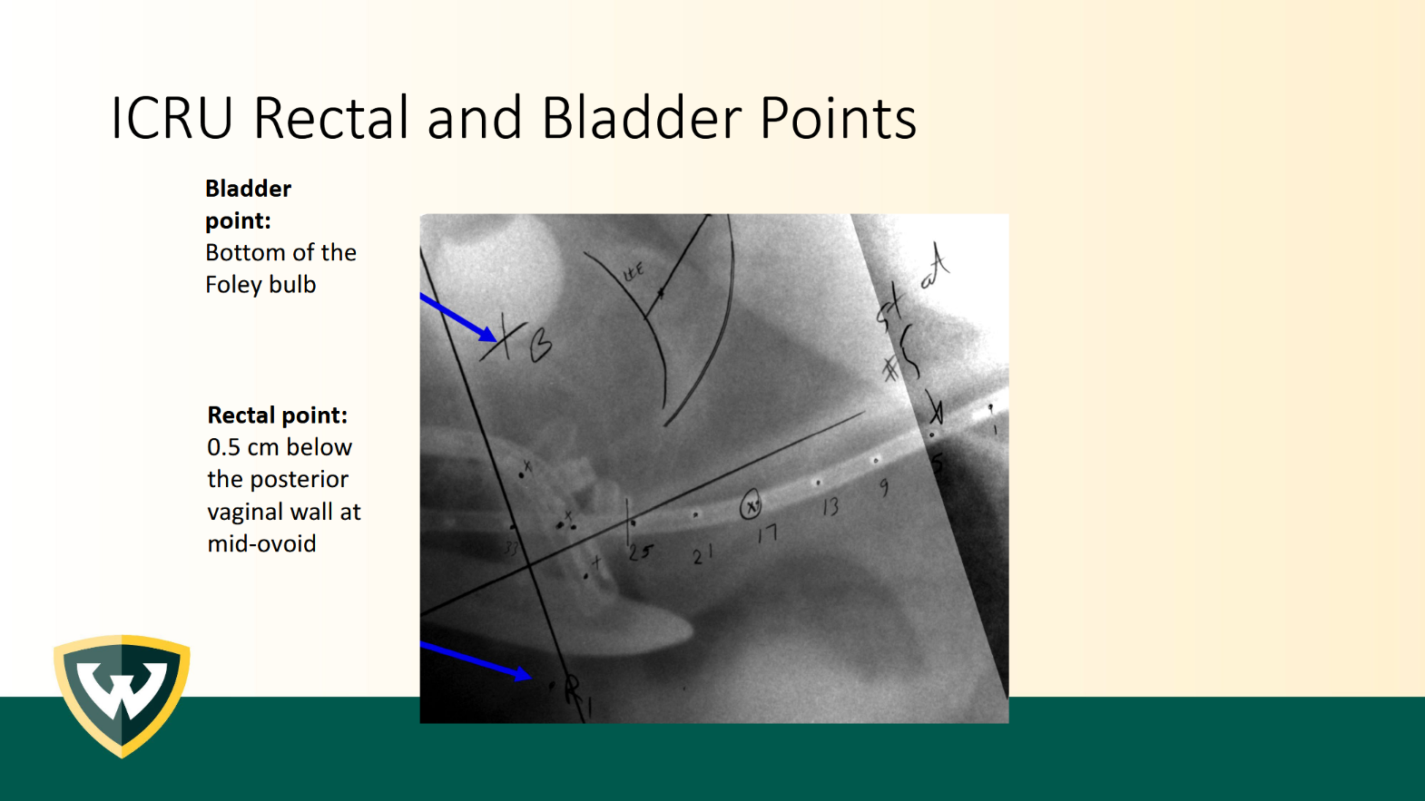

Slide 44


